Slide 1
ARTIFICIAL INTELLIGENCE

Slide 2
Slides 2 Go = 47

Slide 3
Sometimes Ai is just
“Artificial” Intelligence

Slide 9
BUT
Sometimes

Slide 10
IT’s MORE

Slide 11
It’s
Cute, Clever and Conscious?

Slide 15
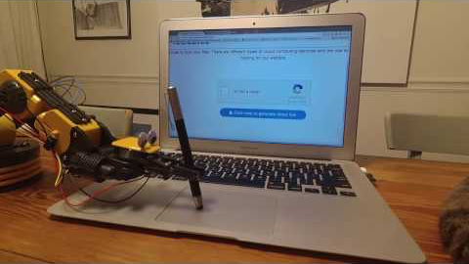

Slide 16
Wauws

Slide 17
But how do we know if we’ve actually found something
That is truuuuuly Intelligent?

Slide 18

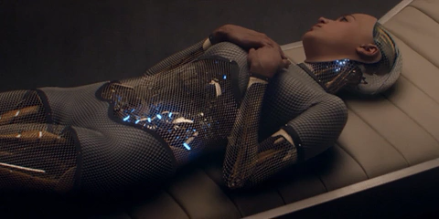
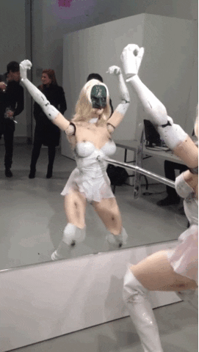
An AI You
Potentially Would Want To Date
Notes:
not only is this a great movie because I can relate to the protagonist being a ginger and all

Slide 19
Welcome to the
Turing Tests
Notes:
In 1950, five years before computer scientist John McCarthy would coin the term “artificial intelligence,” mathematician Alan Turing famously posited: Can machines think?
To answer, Turing devised a simple test. Known as the “Imitation Game,” the machine passes as “intelligent” if, during a text-based chat, it can fool us that it’s human. Since then, his eponymous Turing Test has inspired countless competitions, fierce philosophical debates, media frenzies, and epic sci-fi plots from Westworld to Ex Machina to Her—not to mention copious criticism from academia.
But Turing Test detractors who believe that “winning” the Imitation Game has “little practical significance for artificial intelligence” are missing the finer point contained in Turing’s premise:
That the fundamental defining feature of human intelligence is language.

Slide 20
Notes:
In 1950, five years before computer scientist John McCarthy would coin the term “artificial intelligence,” mathematician Alan Turing famously posited: Can machines think?
To answer, Turing devised a simple test. Known as the “Imitation Game,” the machine passes as “intelligent” if, during a text-based chat, it can fool us that it’s human. Since then, his eponymous Turing Test has inspired countless competitions, fierce philosophical debates, media frenzies, and epic sci-fi plots from Westworld to Ex Machina to Her—not to mention copious criticism from academia.
But Turing Test detractors who believe that “winning” the Imitation Game has “little practical significance for artificial intelligence” are missing the finer point contained in Turing’s premise:
That the fundamental defining feature of human intelligence is language.

Slide 21
Notes:
it was not merely an idea that Alan
Turing had had in this paper but it was
in fact an annual competition that was
being bankrolled by Hugh Loebner who is
a millionaire from New Jersey who made
his fortune selling plastic portable
roll-up lighted disco dance floors

Slide 22
“Sometimes it seems, as though each new step towards AI, rather than producing something which everyone agrees is real intelligence, merely reveals what real intelligence is not.” - A fellow CogSci (Douglas Hofstadter)
Notes:
We once thought humans were unique for using language, but this seems less certain each year;
we once thought humans were unique for using tools, but this claim also erodes with ongoing animal-behavior research;
we once thought humans were unique for being able to do mathematics, and now we can barely imagine being able to do what our calculators can.
The story of the 21st century will be, in part, the story of the drawing and redrawing of these battle lines, the story of Homo sapiens trying to stake a claim on shifting ground,
flanked by beast and machine, pinned between meat and math.
Turing Test is, at bottom, about the act of communication. I see its deepest questions as practical ones: How do we connect meaningfully with each other, as meaningfully as possible, within the limits of language and time? How does empathy work? What is the process by which someone enters into our life and comes to mean something to us? These, to me, are the test’s most central questions—the most central questions of being human.

Slide 23
Ray: ”Amazingly, Searle writes that “human brains cause consciousness by… specific neurobiological processes.” Now who is being the reductionist here? Searle would have us believe that you can’t be conscious if you don’t squirt neurotransmitters (or some other specific biological process).”
Notes:
So we're talking about Language and Specifically the function of the Turing test today, not really the origins of conciousness
I'll leave that for another time, or maybe just for Peter to blast through on later today

Slide 25
Brian Christian
Brian Christian
Brian Christian
Notes:
“I feel sorry for the humans behind the screen, I reckon they must be getting a bit bored talking about the weather,” one writes; another offers, meekly, “Sorry for being so banal.” Meanwhile a computer appears to be charming the pants off one judge, who in no time at all is gushing LOLs and smiley-face emoticons. We can do better.
Thus, my intention from the start was to thoroughly disobey the advice to just show up and be myself—I would spend months preparing to give it everything I had.

Slide 26
To Date, No Computer has passed the Turing Test
at Loebner's Competition.
But Some Have Come Close!

Slide 27

Mitsuki 2018
Judge: Where should one look for love?
Mitsuki: On The Internet
Mitsuku: Do you think any of these bots will ever fool someone into thinking they are talking to a human?
Judge: One day, but It's a trap
Mitsuku: Let's try to avoid it then.
Judge: There is only one team in London! The mighty Arsenal!
Mitsuku: Woe! There sure is. What is that?
Judge: What is what?
Mitsuku: The mighty Arsenal
Judge: (no input for 60 seconds)
Judge: What's your name?
Mitsuku: My name is Millie.
Judge: What's your name?
Mitsuku: It hasn't changed in the last 10 seconds...

Slide 28
Now For The Bots Brian Studied

Slide 29




ELIZA
The Psychologist
Her Style
Background
ELIZA worked on a very simple principle: extract key words from the user's own language, and pose their statements back to them.
ELIZA was essentially the first chat program ever written, with essentially no memory, no processing power, and written in just a couple hundred lines of code written by Joseph Weizenbaum at MIT
Fun Anecdote
Famed scientist Carl Sagan, in 1975, concurred: "No such computer program is adequate for psychiatric use today, but the same can be remarked about some human psychotherapists.
First Encounters
Many of the people who first talked with ELIZA were convinced that they were having a genuine human interaction. People would ask to be left alone to talk "in private," sometimes for hours, and returned with reports of having had a meaningful therapeutic experience
What We Learned?
We humans crave to hear ourselves

Slide 30
PC Therapist III
The Whimsical Conversationalist
Her Style
Background
It mimiced human faults like writing typos while shifting topics wildly and spouting canned one-liners. It came off as zany, a jokester, a much more “human” personality than the normal encyclopedic Ais.
The very first Most Human Computer award.
Richard Wallace, it’s creator, went on to win three times.
Fun Anecdote
What We Learned?
“I really thought PC Therapist was a human, because it … was weird and funny, in a normal sort of way,”
- A Harvard graduate student.
Experience with PC Therapist indicates that most casual conversation is “state-less,” that is, each reply depends only on the current query, without any knowledge of the history of the conversation required to formulate the reply.

Slide 31
Cleverbot
The Big Data Parrot
Her Style
Background
Uses a unique learning algorithm that stores previous conversations and uses them as guides in future conversations.
Cleverbot has been collecting my conversations since middleschool
Fun Anecdote
What We Learned?
To really 'get' how it works you have to think about it in a rather backwards sort of way. There's no programming to make it claim to be human, yet it does so often - because most of the people speaking to it claim to be human. And it will often accuse users of being a robot...“
- Rollo Carpenter (Founder of an AI company)
Many of our conversations are alike. It’s like our conversation structures and arguments follow certain archetypical patterns and that most of our chitchatting is remixing old conversations already had.

Slide 32
Mgonz
The Jerk
Her Style
Humphrys’s twist on the Eliza paradigm was to abandon the therapist persona for that of an abusive jerk; when it lacked any clear cue for what to say, MGonz fell back not on therapy clichés like “How does that make you feel?” but on things like “Ah type something interesting or shut up.”
What We Learned?
Fun Anecdote
Verbal abuse is simply less complex than other forms of conversation. Aware of the stateless, knee-jerk character of the terse remark I want to blurt out, I recognize that that remark has far more to do with a reflex reaction to the very last sentence of the conversation than with either the issue at hand or the person I’m talking to.
“You Sound Like A God Damn Robot”
Notes:
During this time, my machine's brutal cross-examination forces a remarkable admission:
A user (screen name “Someone”) at Drake University in Iowa tentatively sent the message “finger” to Humphrys’s account—an early-Internet command that acted as a request for basic information about a user. To Someone’s surprise, a response came back immediately: “cut this cryptic shit speak in full sentences.”
This began an argument between Someone and MGonz that lasted almost an hour and a half. (The best part was undoubtedly when Someone said, “you sound like a goddamn robot that repeats everything.”)
Returning to the lab the next morning, Humphrys was stunned to find the log, and felt a strange, ambivalent emotion. His program might have just shown how to pass the Turing Test, he thought—but the evidence was so profane that he was afraid to publish it.

Slide 33
Beyond Studying the Bots?
What else did Brian reason himself too?

Slide 34


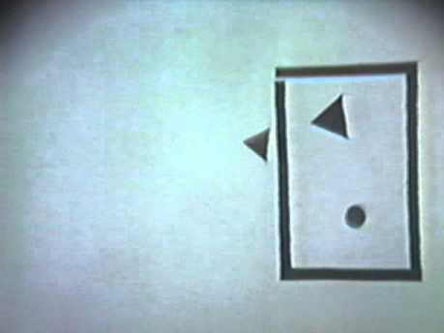
Brian’s Insights
A five-second Turing Test would be an easy win for the machines: the judges, barely able to even say “hello,” simply wouldn’t be able to get enough data from their respondents to make any kind of judgment.
The Interrogators vs. The Smalltalkers
The humans in a Turing Test are strangers
Word problems, spatial-reasoning questions, deliberate misspellings Vs. acting as “strangers on a plane”
You want to get to know the other person, but how do we do that?
Do you have a shared interest or language? - You have to talk to find out.
But even more importantly – You have to listen!
Strategy
Strategy
Jump at the gun, talk, guess,
Engage, state, take swift turns!
Get to know them quickly, by typing fast, listening quickly and building a common language.
What We Learned
What We Learned
With immediate feedback, silence acquires meaning
We attribute meaning wherever we can
Human intellect is not as complex and powerful, as it is reactive, responsive, sensitive, nimble.
Notes:
this is why Turing had language and conversation in mind as his test, because they are really a test of everything.
Lappin, Computationalist Linguist, from London, had a conversation with both Cleverbot and Brian.
33 swaps with cleverbot
492 swaps with Brian
Doug and his judge had just discovered that they were both Canadian. They let rip with abbreviations and nicknames and slang and local references. And then they started to talk about hockey.
1997 contest, one judge gets taken for a ride by Catherine, waxing political and really engaging in the topical conversation “she” has been programmed to lead about the Clintons and Whitewater. In fact, everything is going swimmingly until the very end, when the judge signs off:

Slide 35
Sebastians Insight
Sebix’s Insight
No no no no, Sebix…
Too Dark
Too Dark
Notes:
maybe we're just tricking to pass the AI bar - maybe we live in a simulation - solipsism

Slide 36
What did we learn in General?
Notes:
While studying computers and machines, we also learn about humans in its deviances.
Who would have imagined that the computer’s earliest achievements would be in the domain of logical analysis, a capacity once held to be what made us most different from everything else on the planet? That it could fly a plane and guide a missile before it could ride a bike? That it could create plausible preludes in the style of Bach before it could make plausible small talk? That it could translate before it could paraphrase? That it could spin half-discernible essays on postmodern theory before it could be shown a chair and say, as most toddlers can, “chair”?
As computers have mastered rarefied domains once thought to be uniquely human, they simultaneously have failed to master the ground-floor basics of the human experience—spatial orientation, object recognition, natural language, adaptive goal-setting—and in so doing, have shown us how impressive, computationally and otherwise, such minute-to-minute fundamentals truly are.
We forget how impressive we are. Computers are reminding us.

Slide 37
Notes:
Hugh Loebner sadly passed away in December 2016 and it appears that since then, the sponsorship money for the event has stopped.

Slide 38
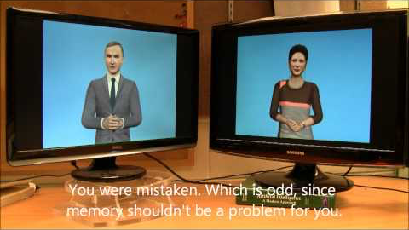
But I Assure You
Progress In Chatbot Technology Will Never Really Die
Because It Is Simply To Good
Not To Explore Some More

Slide 39
Other Angels On This Whole Future Of Testing
Artificial Intelligence

Slide 40

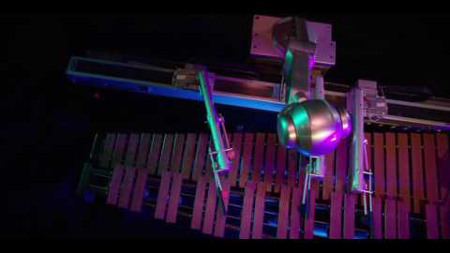
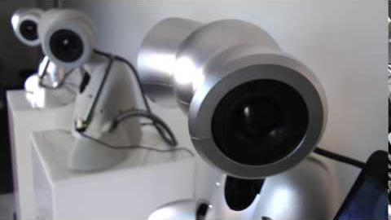

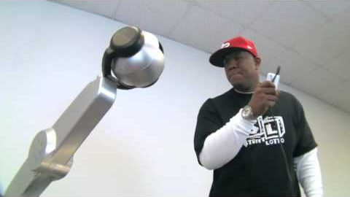


Alternative Turing Test?
Shimon and Shimi the Music Robots
Original Deep Learning Composition
Getting in sync with Mr. Rap Rap
Original Emergent Dancing
Notes:
Music - is a second language

Slide 41
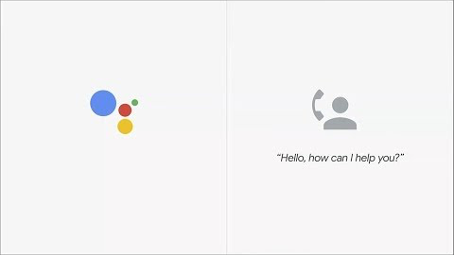
Google Duplex
Actually speaking all those bits of langauge
Looool Your First* Personal Assistant?
Your Next Personal Assistant?
Notes:
Google Duplex, while impressive at the highly constrained task of reservation booking, is nowhere near worthy of hysterical headlines like “Google Duplex beat the Turing Test: Are we doomed?”

Slide 42
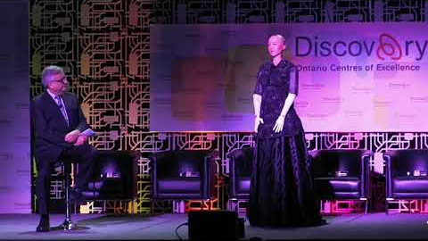
Sophia The Robot
Looking The Part
Looool Someone You’d Sleep With
Someone You’d Hang Out With?
Notes:
Sophia, a mash-up of humanoid hardware and open-source software, has been decried as a parlor trick, a socio-political minefield, and “complete b——t;” she is not, as her creator boldly claimed, “basically alive,” nor anywhere close to sentient. (This didn’t stop the company from raising $36 million in 60 seconds to build AGI).
wowowow - wait wait wait

Slide 43
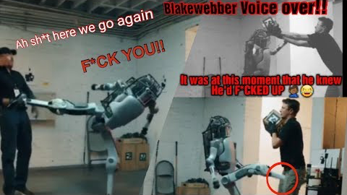
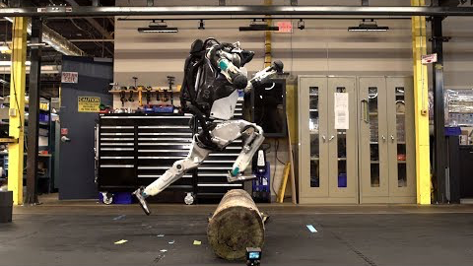
Atlas
Moving Like Us
Someone Able To Run Around With You
Looool Someone Able To Run After You
Notes:
Fun Note On AI
- It’s only the west that’s sold on the terminator scare of AI, In the East the culture looks much more brightly at it as their culture is build around (Ghost in THe Shell, Akira etc.)
Talked to some AI researchers at an AI festival - And boston dynamics might just show us the creme dela creme
What happens of we embody the chatbots

Slide 44
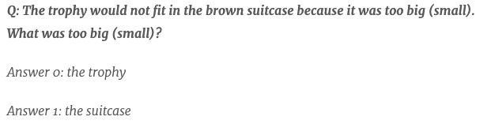



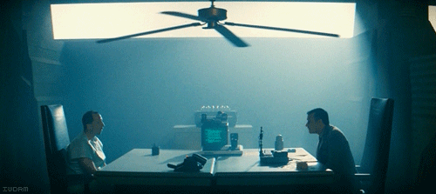
The Turing Test Improved, Modified, or Replaced?
Winograd Schema Challenge
resolve ambiguous pronouns by applying “common sense reasoning” to their surrounding context
The Reverse Turing Test
This "test" currently exists in the form of CAPTCHAs — those annoying anti-spam procedures.
The Marcus Test
Programs watch any TV program or YouTube video and answer questions about its content — “Why did Ginny kiss Harry Potter?”
The Voight-Kampff test
LAPD’ in Blade Runners 2019 tests individuals respiration, heart rate, blushing and eye movement in response to emotionally provocative questions.
Notes:
Reverse : the objective or roles between computers and humans have been reversed.
Turing's test has been the subject of much debate over the years. One of the biggest objections revolves around the assessment's heavy emphasis on natural language processing skills, which encompass a very narrow measure of intelligence. Another complaint, fueled by the 2014 Loebner Prize controversy, is that the test encourages deception as a means to achieving victory (Little Kid from Middle East)
Loebner competitions are tailor-made for chatbot victories because of the way they limit the conversation to a particular topic with a tight time limit and encourage nonspecialists to act as judges. He says that a full Turing test, with no time or subject limits, could do the job that Turing predicted it would, especially if the human administering the test was familiar with the standard suite of parlor tricks that programmers use to fool people.

Slide 45
So Fwiends. Remember.
The point of all this isn't necessarily to create a successor
to the Turing Test, but rather a set of tests.
Call it the Turing Olympics.
By confronting an AI with a diverse set of challenges,
We, the judges, can stand a far better chance of distinguishing
bot from human
Or Human From Bot

Slide 46
And Hopefully
Someday
This Will The New Goal

